Slide 1

WELCOME

Slide 2

Praga HEALTH mIX

Slide 3
Project Overview
Analyzed customer churn data to uncover trends and high-risk segments. Leveraged data analytics tools to support targeted retention initiatives and enhance customer loyalty .

Slide 4
Tools utilized
EXCEL :Performed data cleaning and preprocessing in excel to ensure accurate churn analysis.
SQL :Used SQL queries on customer, services and billing data to uncovered churn pattern and top spending customers for retention insights
PYTHON: Applied python (Pandas , Seaborn , Matplotlib ) to explore churn trends, visualize key relationships and identify high-risk customer segments .
POWER BI : Created interactive power bi dashboards to monitor churn metrics, visualize trend, and support data – driven retention decisions.

Slide 5

EXCEL

Slide 6
EXCEL DATA CLEANING
Remove Duplicates
Eliminated repeated customer records to ensure data accuracy and uniqueness .
2. Handle Missing Values
Identify any blank or missing entries in Total charges and replace or fill them to ensure complete and accurate data for analysis.

Slide 7
Encouraging customers to move from month-to-month plans to yearly contracts can help reduce churn.
The Month-to-Month contract has the highest churn rate, meaning customers with short-term plans are more likely to leave.
The One Year and TwoYear contracts have lower churn, showing that long-term customers are more loyal and stable.

Slide 8


Slide 9
SELECT PaymentMethod,
ROUND(SUM(CASE WHEN Churn='Yes' THEN 1 ELSE 0 END)*100.0/COUNT(*), 2) AS ChurnRate
FROM ChurnData
GROUP BY PaymentMethod
ORDER BY ChurnRate DESC;
Payment Method | ChurnRate
Electronic Check | 45.29
Mailed Check | 19.20
Bank transfer (automatic) | 16.73
Credit Card (automatic ) | 15.25
This SQL query calculates churn rate for each payment method.
It helps identify which payment type has the highest customer churn.

Slide 10
Customer ID | Total Charges
2889-FPWRM | 8684.8
7569-NMZYQ | 8672.45
9739-JLPQJ | 8670.1
9788-HNGUT | 8594.4
8879-XUAHX | 8564.75
9924-JPRMC | 8547.15
0675-NCDYU | 8543.25
6650-BWFRT | 8529.5
0164-APGRB | 8496.7
1488-PBLJN | 8477.7
SELECT
customer ID,
Total Charges
FROM Billing
ORDER BY Total Charges DESC
LIMIT 10;
The query retrieves the top 10 customers with the highest total charges.
It helps the company identify high-value customers and focus on retention and loyalty programs.

Slide 11

PYTHON

Slide 12
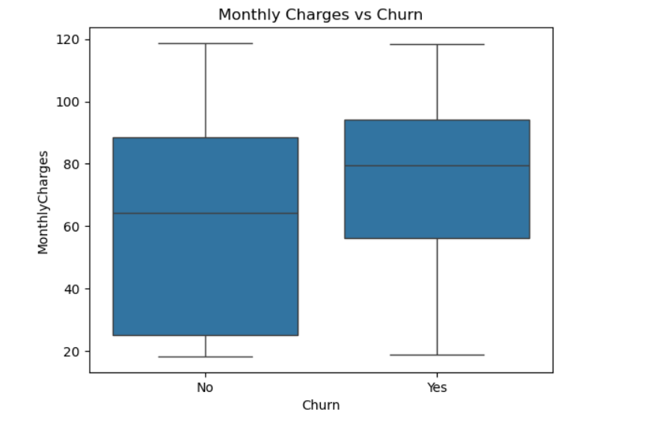
sns.boxplot(x='Churn', y='MonthlyCharges', data=dataset)plt.title('Monthly Charges vs Churn')plt.show()

Slide 13
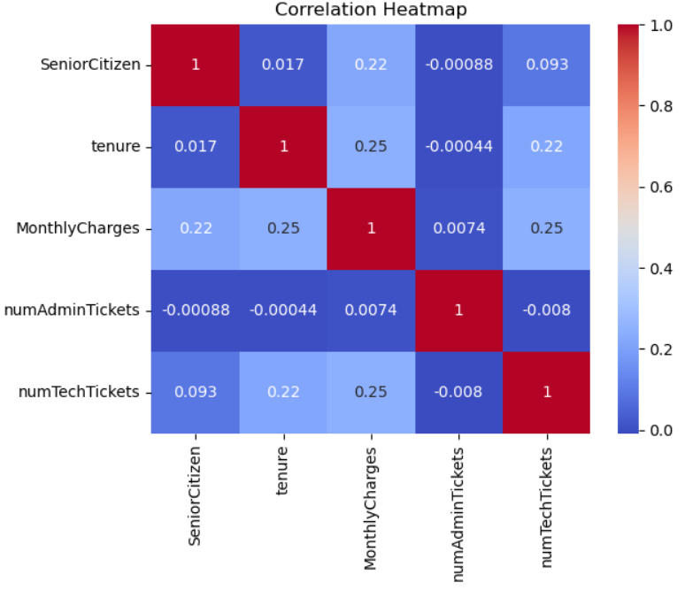
corr = dataset.corr(numeric_only=True)sns.heatmap(corr, annot=True, cmap='coolwarm')plt.title('Correlation Heatmap')plt.show()

Slide 14


Slide 15
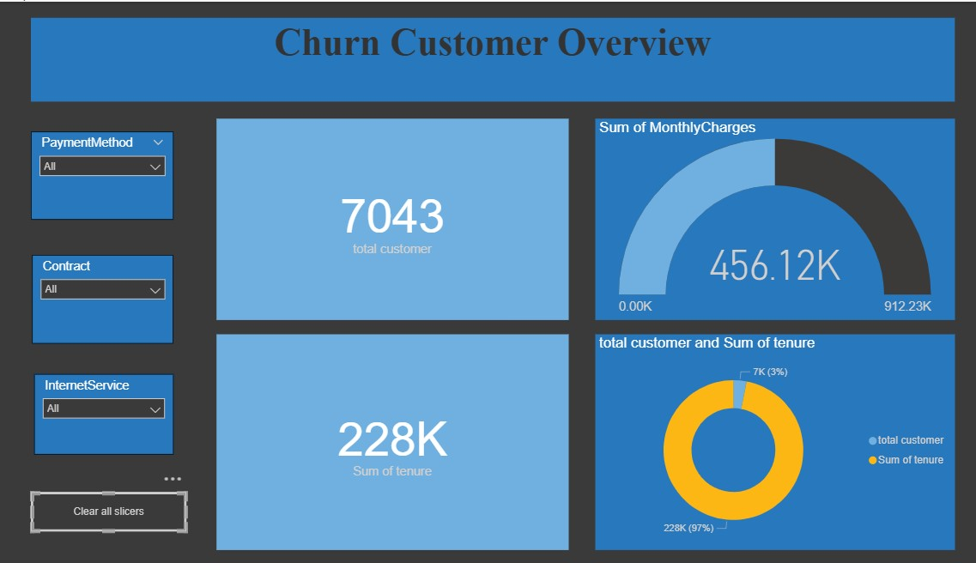
This dashboard shows an overview of total customers, sum of tenure, and sum of monthly charges with filter options.

Slide 16
Churn similar by gender, higher for short-term contracts and some payment methods, moderate for senior citizens.

Slide 17
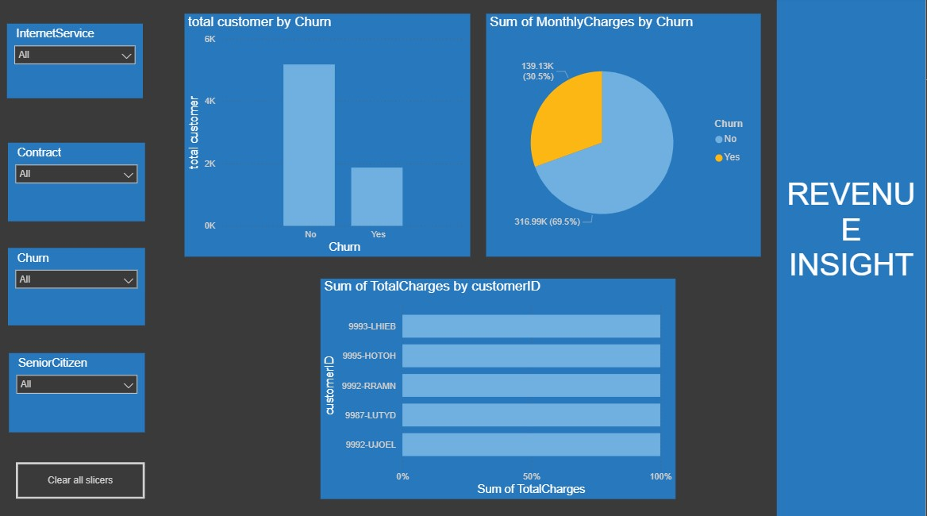
Non-churned customers have slightly higher tickets and charges; top 5 customers drive most revenue.

Slide 18

SRIPRIYANKA M

